Slide 1
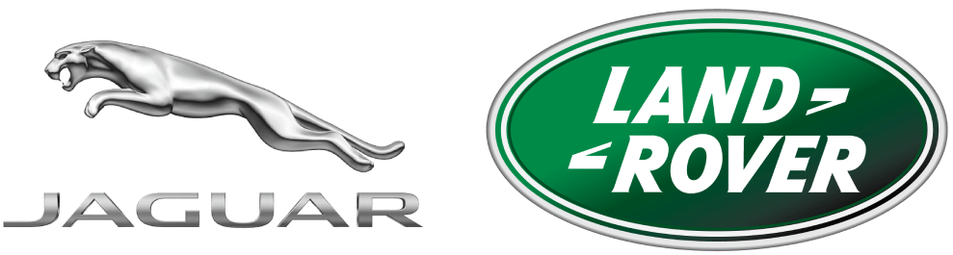
Detailed Analysis of whether Jaguar Landover should start Manufacturing in India
GROUP MEMBERS
NIHAL SINGH RAGHAV (pd15_117)
MOHD JAVED (PD15_239)
SIMARAN RAGHUVANSH (PD15_227)
PUSHPENDER KUMAWAT (PD15_148)

Slide 2

OUTLINE
Introduction Of Jaguar Landover
Market Share / Business Insights
Exporting and offshore assembly cost
The average cost of labor in India
Current Manufacturing Strategy
Income and global sales representation
Reasons behind Tata Motors take over Jaguar Land Rover
Conclusion

Slide 3
introduction
Jaguar Land Rover Automotive PLC is the holding company of Jaguar Land Rover Limited (also known as JLR) and is a British multinational automobile manufacturer that produces luxury vehicles and sport utility vehicles.
Jaguar dates back to the 1930s and Land Rover dates back to the 1940s.
Tata Motors launched it as a holding company for the acquisition of Jaguar Cars Limited and Land Rover Limited from Ford in 2008.

Slide 4
History
1935
The first Jaguar goes on Sale in the UK.
The Wilks Brothers Make history with the UK’s first Off-Roaders in the original Land Rovers.
1948
The iconic Jaguar E-Type Launches at the Geneva Motor Show.
1961
The Land Rover enters the world bringing with it a new type of vehicle -- the luxury SUV.
1970
1978
The Land Rovers separate from its present company Rover and become it own entity.
The Land Rovers Defenders comes into being.
1990
1994
BMW take over the Rover Group.
The Land Rover brand was sold to Ford.
2000
Land rover and Jaguar both sold to Tata and combined to create the Jaguar Land Rover Brand of Today.
2008
The world’s first all-electric SUV the I-Pace goes into production.
2018

Slide 5

Market Share
Jaguar Land Rover aims at 14% market share in India this year.
The new Discovery at Rs 71.38 lakh, we have filled the gap between the Discovery Sport and Range Rover Sport
In 2018, we have plans to knock out our closest competitor to take on the third position
Audi sales in May fell 31% to 7,742 units in India, compared to BMW’s 7,861, a rise of 14%.
JLR’s market share strategy includes focusing on petrol engines, strengthening its dealer network, and after-sales service.
The company has 25 dealerships in India, with a presence in all tier-I and tier-II cities
95% of our models sold were diesel (engines) but after the NCR (Delhi region) diesel ban (on high-engine cars), we noticed a considerable hike in demand for petrol cars.
25% of the JLR volumes sold are petrol-run vehicles.

Slide 6
Financial Information
Here is a summary of financial information of JAGUAR LAND ROVER INDIA LIMITED for the financial year ending on 31 March, 2022.
Revenue / turnover of JAGUAR LAND ROVER INDIA LIMITED is Over INR 500 cr
Net worth of the company has increased by 70.31 %
EBITDA of the company has increased by 104.33 %
Total assets of the company has increased by 0.19 %
Liabilities of the company has decreased by -32.06 %

Slide 7
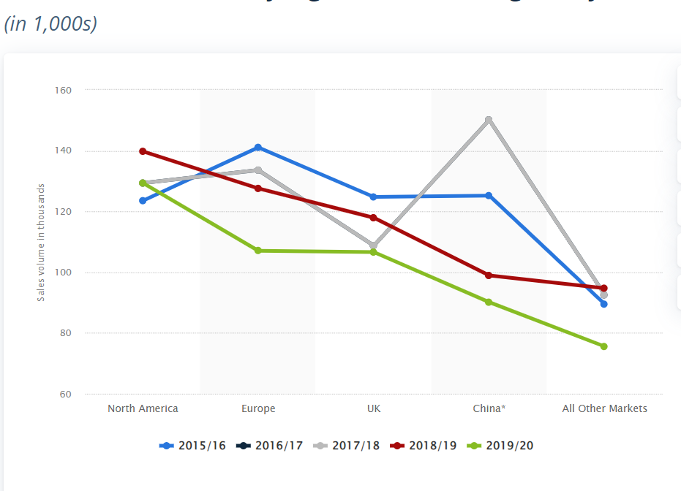
global market presence and market share
The United States has emerged as the most important sales market for Jaguar Land Rover. In 2019, the luxury car manufacturer sold roughly 106,600 vehicles in its home market, which was slightly less than the number sold in the rest of Europe. Apart from sales to North America, Jaguar Land Rover suffered a sales decline in all its main markets. Business with China, the world’s largest automobile market, declined by 8.9% between 2018 and 2019. The two longstanding British car brands have been a subsidiary of Tata Motors since 2008 and were individually owned before.
Revenue development:
In its 2019 fiscal year, Jaguar Land Rover generated 24.2 billion British pounds in sales revenues. As a result of declining demand, figures for 2019 were lower than those reported the previous year, the peak at 25.8 billion British pounds.
Retail sales over the years:
Overall, the company’s retail volume amounted to some 509,000 units in the 2020 fiscal year. Between 2011 and 2018, Jaguar Land Rover steadily increased their sales output, before figures dropped in 2019. Nevertheless, the past nine years have seen retail volume more than double, suggesting a healthy growth rate.

Slide 8
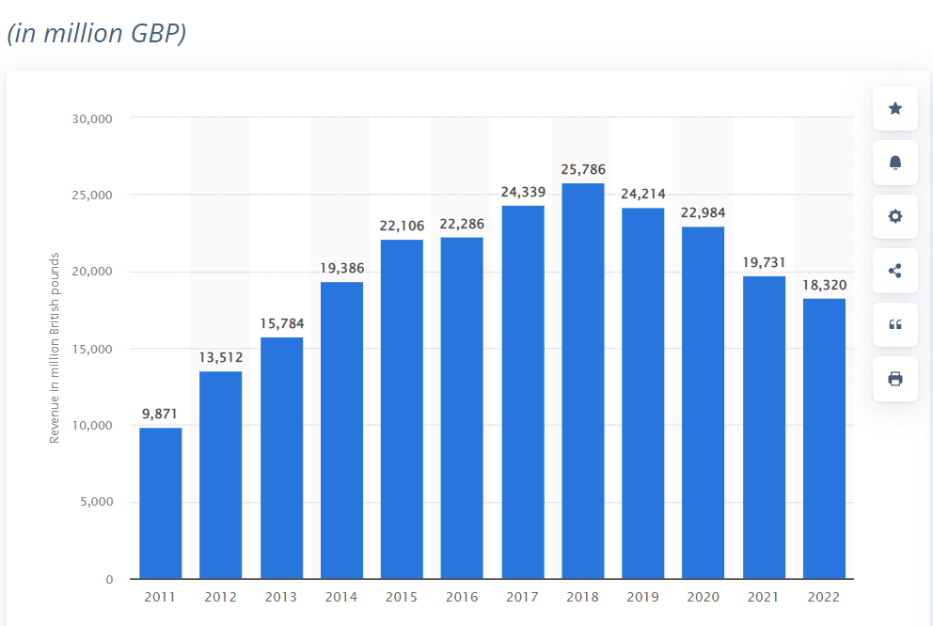
Revenue Model
Jaguar land Rover: Global Sales revenue 2011-2022
In the 2022 fiscal year, Jaguar Land Rover generated over 18.3 billion British pounds in sales revenue. Jaguar Land Rover Automotive was established as a subsidiary of Indian automaker Tata Motors in 2008, which marked the first time that both long-standing car brands were owned by the same parent.

Slide 9
Current manufacturing strategy
Jaguar Land Rover (JLR) currently assembles some cars in India with parts shipped from Britain.
Like Brazil, India is one of the possibilities for Jaguar Land Rover to fully manufacture cars.
JLR assembles two of its vehicles at its west India plant using kits, engines, and gearboxes imported from Britain.
Sales of Jaguar and Land Rover models have been key growth drivers for Tata Motors
Indian car sales have slowed in the last year due to high borrowing costs, costly fuel, and increased prices due to increased raw material costs.
Tata Motors bought Jaguar and Land Rover from Ford Motor Co. in 2008 for $2.3 billion as part of plans to expand its reach beyond Asia.
JLR reported record global sales of 357,773 vehicles in 2012, a 30% year-on-year rise, led by strong demand in China, Britain, and the United States.

Slide 10

Reasons behind Tata Motors take over Jaguar Land Rover
Tata bought Jaguar and Land Rover in an all-cash transaction of $2.3 billion from Ford in June 2008.
Nearly half of what Ford Motor paid to acquire both brands.
JLR's retro designs were getting outdated, and competing with new efficient diesel engines was just making the British carmaker redundant.

Slide 11
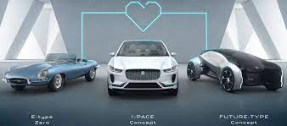
Future Goals
A sustainability-rich reimagination of modern luxury, unique customer experiences, and positive societal impact
Reimagination of Jaguar as an all-electric luxury brand from 2025 to ‘realise its unique potential’
In the next five years, Land Rover will welcome six pure electric variants as it continues to be the world leader of luxury SUVs
All Jaguar and Land Rover nameplates to be available in pure electric form by end of the decade; first all-electric Land Rover model in 2024
Their aim is to achieve net zero carbon emissions across our supply chain, products and operations by 2039

Slide 12
conclusion
Tata Motors-owned Jaguar Land Rover (JLR) has no plans to set up a manufacturing facility in India to make premium cars as the country currently is not a market for them, its CEO Ralf Speth said today.
"Localisation is a step-by-step process. Manufacturing is always a possibility in India. It will depend on India’s development of its economy. At this moment, India is not a market for premium cars in terms of volumes that justify building a plant there," he said.
"If it were to explode in terms of GDP and come closer to the Chinese market of 24 million cars a year, we can think about a unit in India," he said. In the rapidly expanding luxury car market in India, however, JLR lags behind premium German rivals like Audi, Mercedes-Benz, and BMW. But the company chief is not too worried about a "niche player" with a smaller product range.
"The clear task is to win and in the segments, we are competing in, we are very well positioned," he said, adding that plans are a little way off for the firm, which currently assembles cars as completely knocked down (CKD) units at its Pune plant, to manufacture them in India.

Slide 13
